Slide 1
Serverless Functions

Slide 2
Agenda
“Serverless” vs serverless
Pros / cons
FaaS principles
Kode eksempel

Slide 3
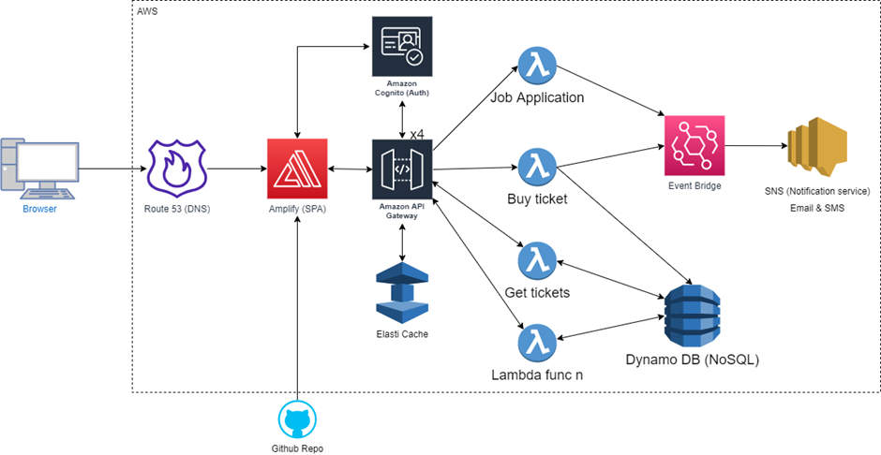
Serverless
“Serverless”
BaaS
Client apps (fully) reliant on 3rd party services
Rich SPA/Mobile App
Serverless Functions
FaaS
Dynamically allocated compute
Custom business logic in Cloud
Triggers (Events)
DB writes
HTTP endpoints
Time of Day

Slide 4
Pros/Cons
Ease-of-use
Scalability
Cost
pay-per-ms
Cold start
Attack Surface
Platform lock
Debugging/Profiling

Slide 5
FaaS Principles
Stateless
Reduce startup time (- dependencies)
Single Responsibility Principle
Event-driven Architecture (Push-driven pipeline)
Utilize 3rd party
Offload to frontend

Slide 6
Kode eksempel med Serverless på Firebase

